Slide 1
The Future is Now: Vehicle’s Self-Driving

Slide 2
CONTENTS
Introduction to Self-Driving Vehicles
Benefits of Self-Driving Vehicles
Challenges of Self-Driving Vehicles
Impact on Society
Legal and Regulatory Issues
The Future of Self-Driving Vehicles

Slide 3
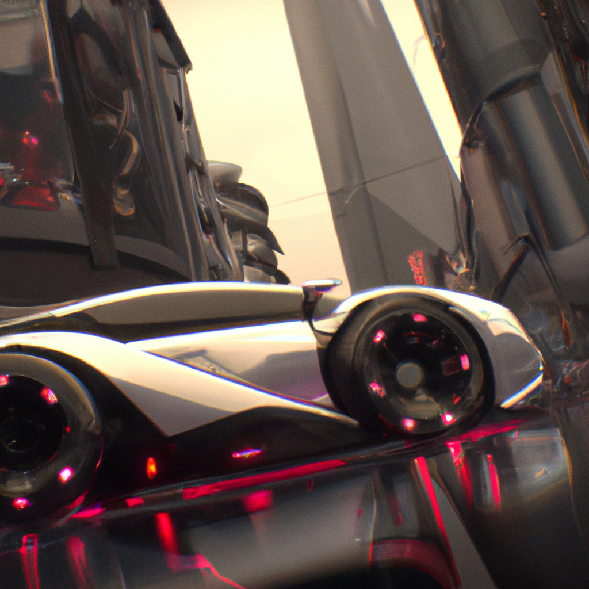
Introduction to Self-Driving Vehicles
Self-driving vehicles, also known as autonomous cars, are vehicles that can operate without human intervention. These vehicles use a combination of sensors, cameras, and software to navigate roads and make decisions based on the surrounding environment.
The development of self-driving vehicles has been a major focus for many companies in recent years, with the goal of improving increasing mobility for people who are unable to drive.

Slide 4

PRODUCT BENEFITS
Self-driving vehicles can optimize their routes and driving behaviors, resulting in improved fuel efficiency and reduced traffic congestion. This can lead to lower operating costs for businesses and reduced environmental impact.
Self-driving vehicles can improve accessibility for people who are unable to drive, such as the elderly and disabled. This can provide greater independence and mobility for these individuals.
It has the potential to reduce accidents caused by human error, such as distracted driving, speeding, and drunk driving. This can result in fewer injuries and fatalities on the roads.

Slide 5

Challenges of Self-Driving Vehicles
Despite the potential benefits, there are still several challenges that must be addressed before self-driving vehicles can become widely adopted. One of the biggest challenges is ensuring the safety and reliability of these vehicles, particularly in complex driving situations such as bad weather or construction zones.
Another challenge is addressing ethical concerns related to decision-making. For example, if a self-driving car is faced with a situation where it must choose between two potentially harmful outcomes, how should it make that decision? These are complex questions that require careful consideration and planning.

Slide 6
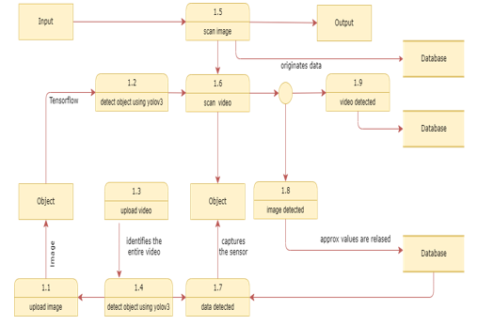
Solution: Algorithm
DFD LEVEL 1

Slide 7
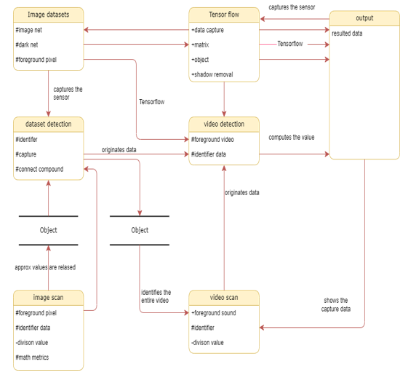
DFD LEVEL 1

Slide 8
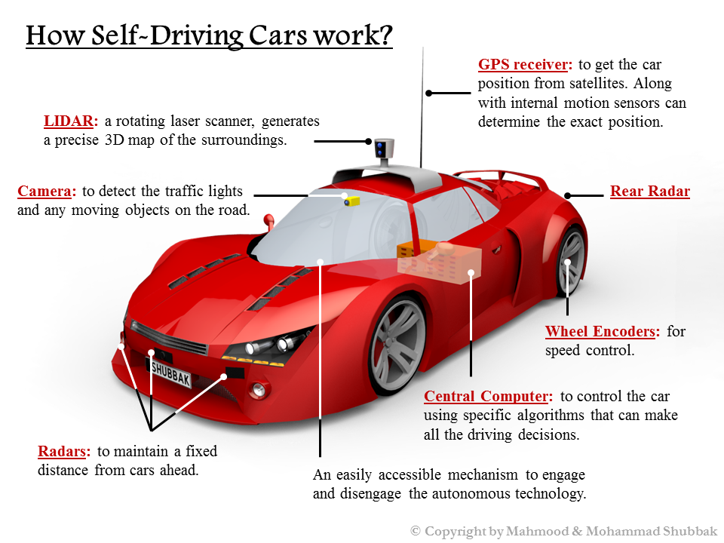
MECHANISM:

Slide 9
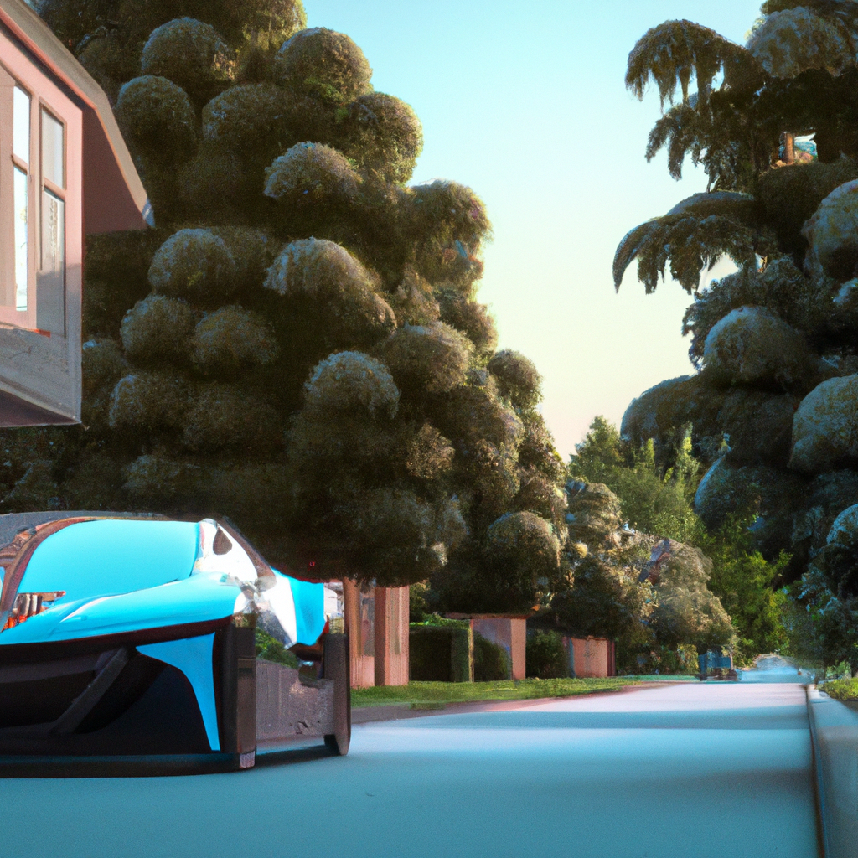
Impact on Society
Self-driving vehicles have the potential to significantly impact society in a number of ways. For example, they could improve access to transportation for people who are unable to drive due to age or disability. They could also reduce the need for parking spaces and garages, freeing up valuable land for other uses.
However, self-driving vehicles could also have negative impacts on society. For example, they could lead to job loss for drivers and others in the transportation industry. They could also exacerbate existing inequalities if they are only accessible to those who can afford them.

Slide 10
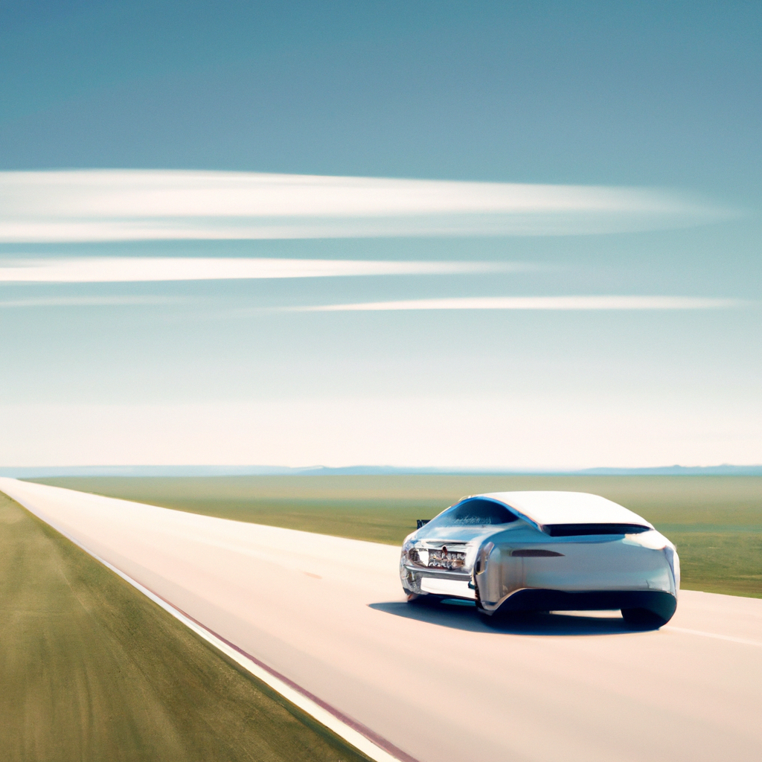
Legal and Regulatory Issues
As self-driving vehicles become more common, there are a number of legal and regulatory issues that must be addressed. For example, who is responsible if a self-driving car is involved in an accident? How will insurance policies need to change to account for the new risks and liabilities?
There are also questions about how self-driving vehicles will be integrated into existing transportation systems, and how they will interact with human-driven vehicles on the road. These are complex issues that require careful consideration and collaboration between government agencies, industry leaders, and other stakeholders.

Slide 11
The Future of Self-Driving Vehicles
Despite the challenges and uncertainties surrounding self-driving vehicles, many experts believe that they represent the future of transportation. As the technology continues to evolve and improve, self-driving cars could become safer, more efficient, and more accessible to people around the world.
Ultimately, the success of self-driving vehicles will depend on a number of factors, including public acceptance, regulatory support, and ongoing technological advancements. However, if these challenges can be overcome, self-driving vehicles have the potential to revolutionize the way we travel and live our lives.

Slide 12
CUSTOMERS
Ride-hailing and Taxi Services
Commercial Fleets
Public Transportation
Personal Use

Slide 13
COST VALUATION ANALYSIS – SELF-DRIVING-VEHICLE
Research and Development Costs: Developing self-driving vehicle technology can be expensive, as it requires extensive research and development to design and test the technology. The costs associated with research and development will depend on the complexity and scope of the project.
Manufacturing Costs: Once the technology has been developed, manufacturing self-driving vehicles can also be expensive, as it requires specialized equipment and materials. The costs associated with manufacturing will depend on the production volume and supply chain logistics.
Maintenance and Repair Costs: Self-driving vehicles will require maintenance and repair, just like traditional vehicles. However, the costs associated with maintenance and repair may be different for self-driving vehicles due to their advanced technology.
Regulatory and Legal Costs: Self-driving vehicles may be subject to additional regulatory and legal requirements, which can increase the overall cost of developing and operating the vehicles.

Slide 14

MARKET OVERVIEW (PREDICTED)
$1400 Million
Total Market Value of the Self-Driving-Vehicle Industry

Slide 15
COMPETITors
Tesla Inc
Nvidia
Waymo
zoox

Slide 16

Growth strategy
MAY 2023
Establish a Strong Research and Development Team: A key to success in the self-driving vehicle industry is having a strong research and development team. This team should be comprised of experts in areas such as robotics, machine learning, artificial intelligence, and automotive engineering.
Nov 2023
Develop Partnerships with Industry Leaders: Self-driving vehicles require advanced technology, and it can be difficult for a startup to develop all the necessary technology on their own. Partnering with established industry leaders, such as automotive manufacturers and technology companies, can provide access to expertise, resources, and funding.
APril 2024
Conduct Extensive Testing and Validation: Self-driving vehicles need to be extensively tested and validated to ensure they are safe and reliable. This can involve testing on closed courses, public roads, and in a variety of weather conditions.

Slide 17
JAN 2025
Launch in Targeted Markets: Launching self-driving vehicles in targeted markets can help to build a customer base and generate revenue. For example, launching in densely populated urban areas or in industries such as ride-hailing or logistics can help to establish a foothold in the market.
June 2025
Expand to Additional Markets: Once a strong customer base has been established, self-driving vehicle companies can expand to additional markets. This can involve expanding to new geographic regions or to additional industries, such as public transportation or personal vehicles.
Continuous Deployment and Maintenance
Continuously Improve Technology and Services: Self-driving technology is constantly evolving, and companies need to continuously improve their technology and services to stay competitive. This can involve investing in research and development, partnering with other companies, and responding to customer feedback.

Slide 18

Summary
In conclusion, self-driving vehicles have the potential to revolutionize the transportation industry by offering a safer, more efficient, and more convenient mode of transportation. While the technology is still in its early stages of development, significant progress has been made in recent years. Self-driving vehicles offer a range of product benefits, including increased safety, improved efficiency, increased accessibility, enhanced comfort and convenience, and reduced costs. A growth strategy for self-driving vehicles could involve building a strong research and development team, developing partnerships, testing and validating technology, launching in targeted markets, expanding to additional markets, and continuously improving technology and services. While there are still challenges to overcome, such as regulatory and legal hurdles, the potential benefits of self-driving vehicles make them an exciting area of development for the future of transportation.

Slide 19
THANK YOU

